Slide 1
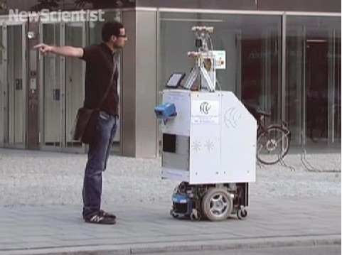
Lab 5:
Local Navigation and Error Analysis
Team 6 (The Sentinels) is…
Daniel Gonzalez
Neil Forrester
Raghavendra Srinivasan
James Wiken

Slide 2
Lab 5 Goal
Given Bump and Sonar sensing…
  [picture]
…avoid collisions with and map out an obstacle
  [picture]

Slide 3
Accomplishing our Goal
Sensor Integration
  [Picture of Sensors]
Orient robot with obstacle using sensors
  Head-on Collision detection
  Sonar readings for driving along wall
Build a map of the obstacle using sensors
  [Screenshot of map being made]

Slide 4
Overcoming Sensor Shortcomings
The Facts:
  Sonars only effective on perpendicular surfaces
  [picture of robot parallel to to wall]
  Bump sensors only effective for head-on collisions
  [picture of robot head-on with wall]
Use them in Tandem for robust sensing!
  First: Align robot head-on with Bump Sensors
  Then: Turn until we are perpendicular to use Sonars

Slide 5
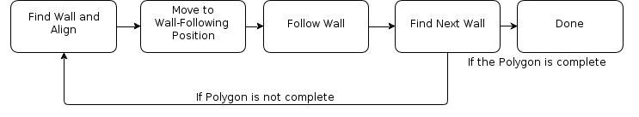
Robot Behavior: Finite State Machine
Start →

Slide 6
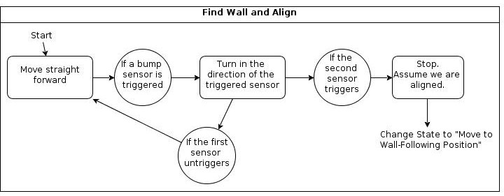
Find Wall and Align

Slide 7
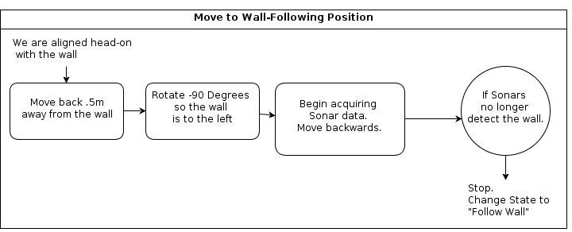
Move to Wall-Following Position

Slide 8
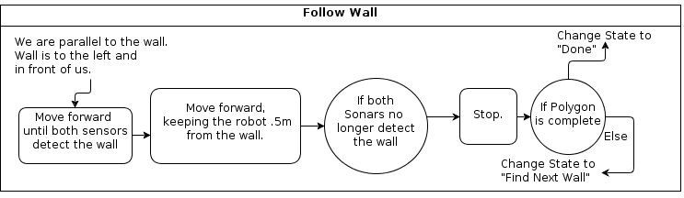
Follow Wall

Slide 9
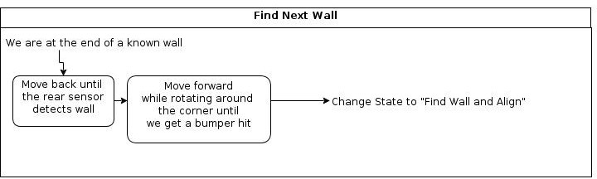
Find the Next Wall

Slide 10

Video!

Slide 11
What We Learned
Neil works best alone.
Matrices are useful
It is difficult to successfully robot.
ROS is terrible

